Slide 1
My Technology Portfolio
Mr. Mark Poley

Slide 2
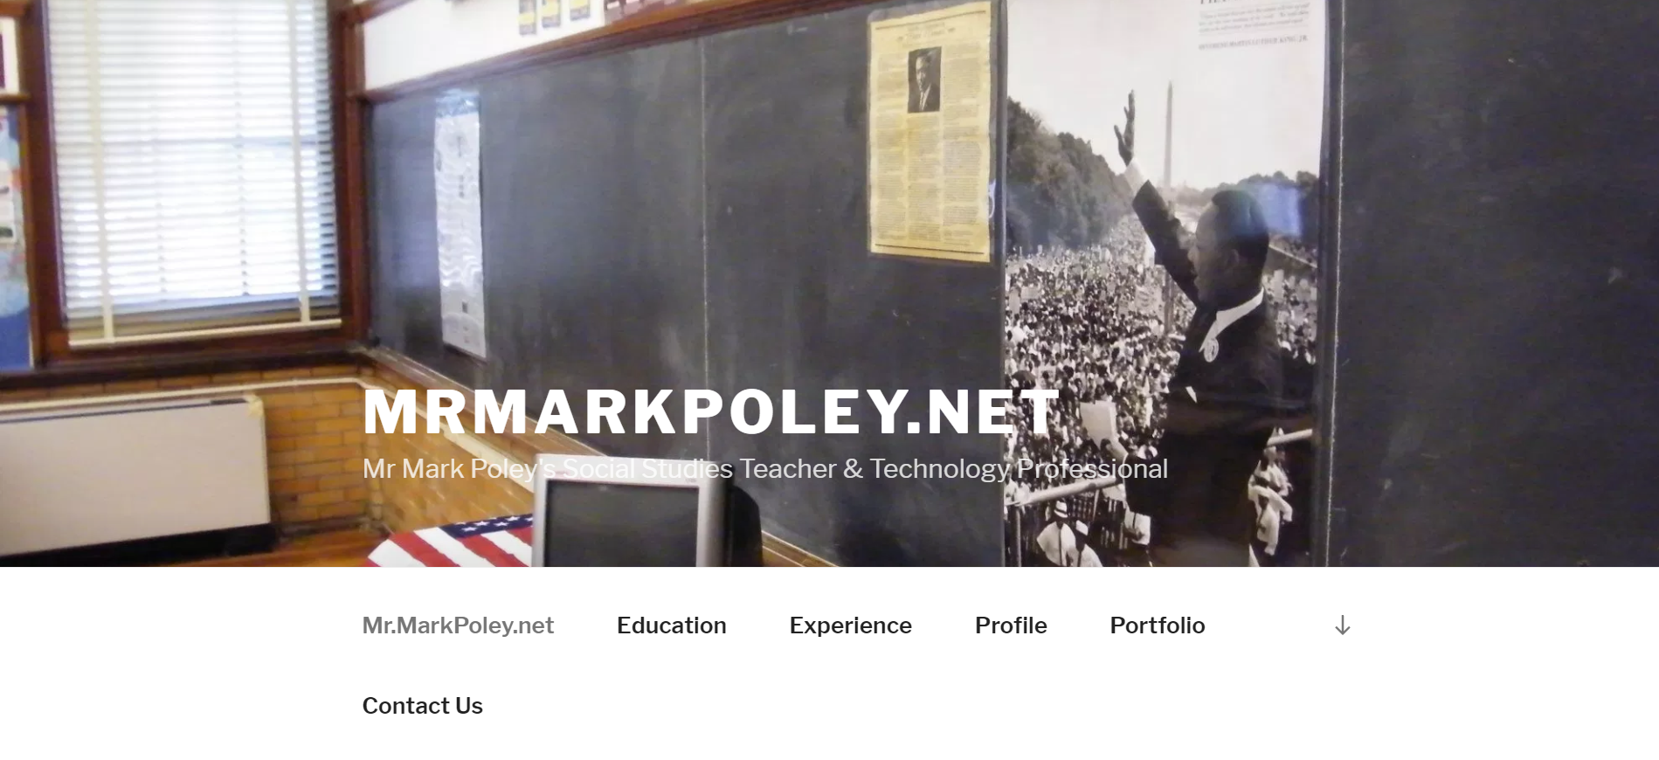
MrMarkPoley.net

Slide 3
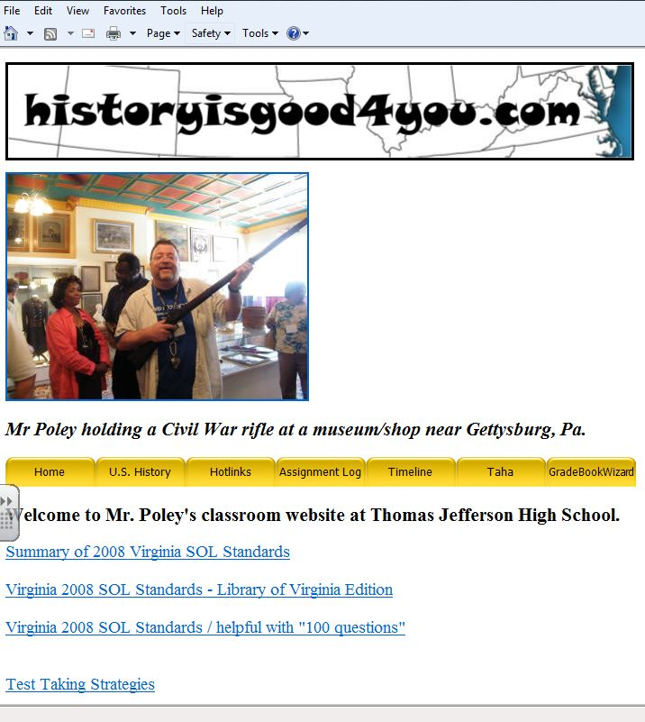
Historyisgood4you.com
I have always known the power of having a website. Having been an independent webmaster, I knew that having a website would afford immense benefits to my students, parents, and the world outside my classroom. I have revised my site many times during my eleven years as a teacher. I have utilized many different tools to include Microsoft FrontPage, Macromedia Dreamweaver, Microsoft Web Expression, and WordPress.

Slide 4
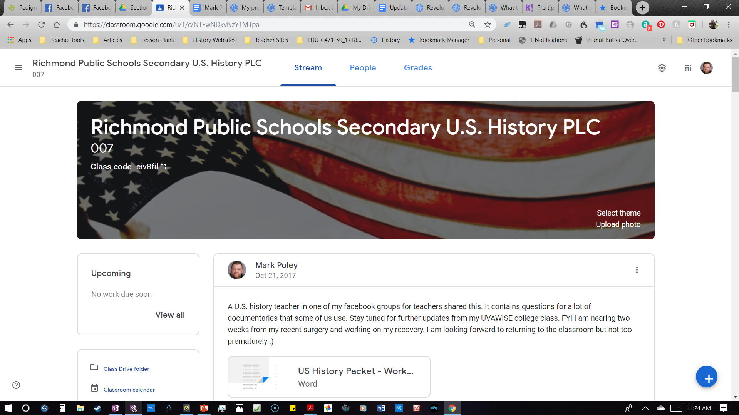
Google Classroom U.S. History P.L.C.

Slide 5
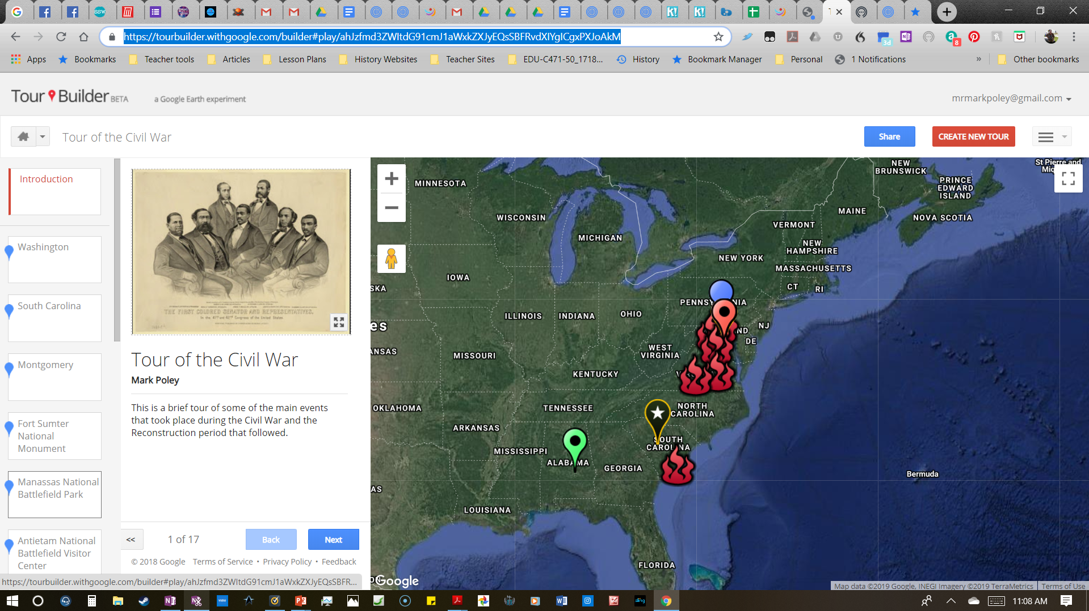
Google Tour Builder - Tour of the Civil War

Slide 6
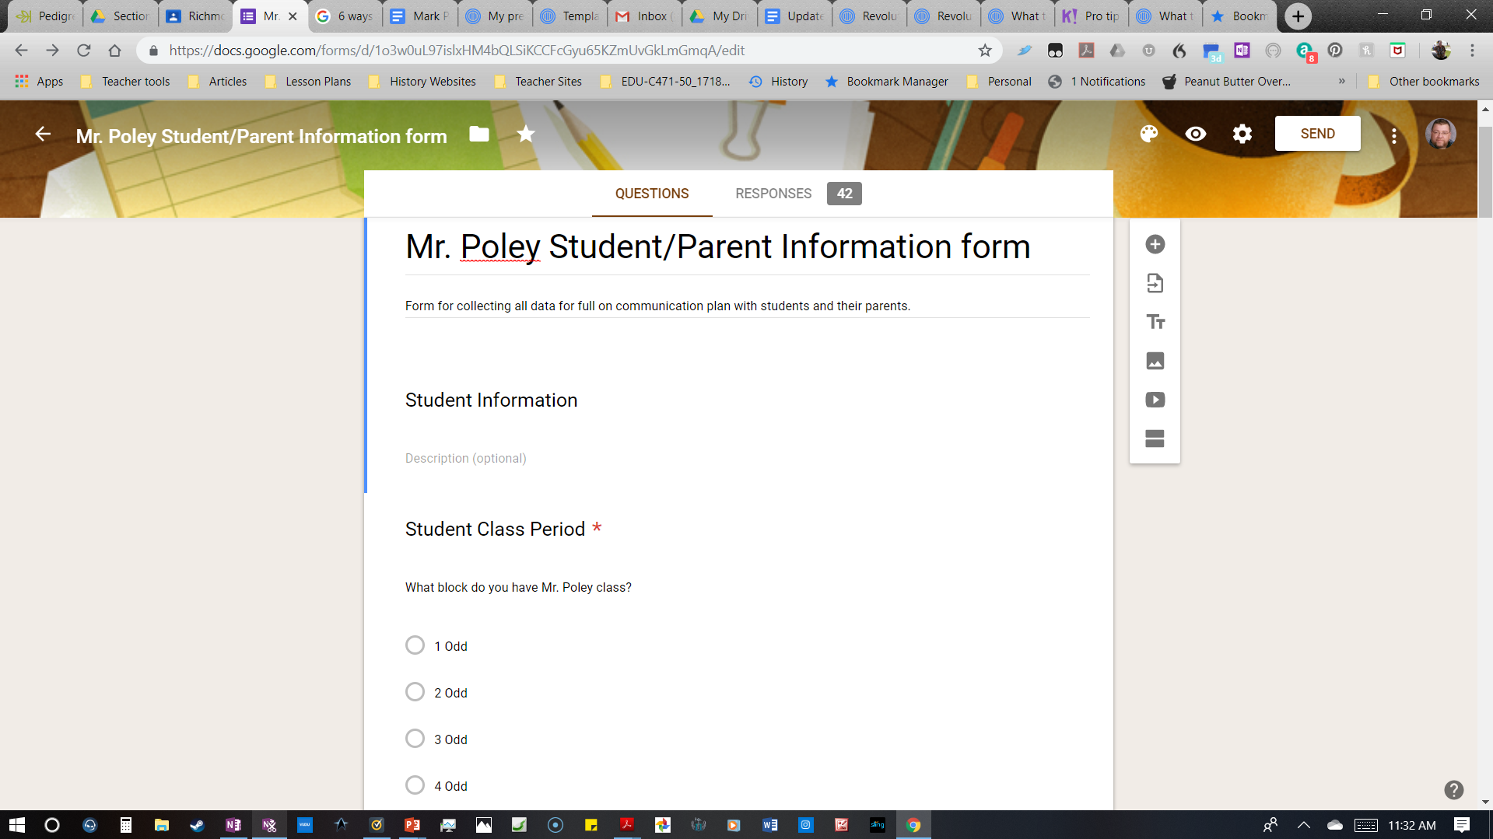
Student/Parent Information Google Form

Slide 7
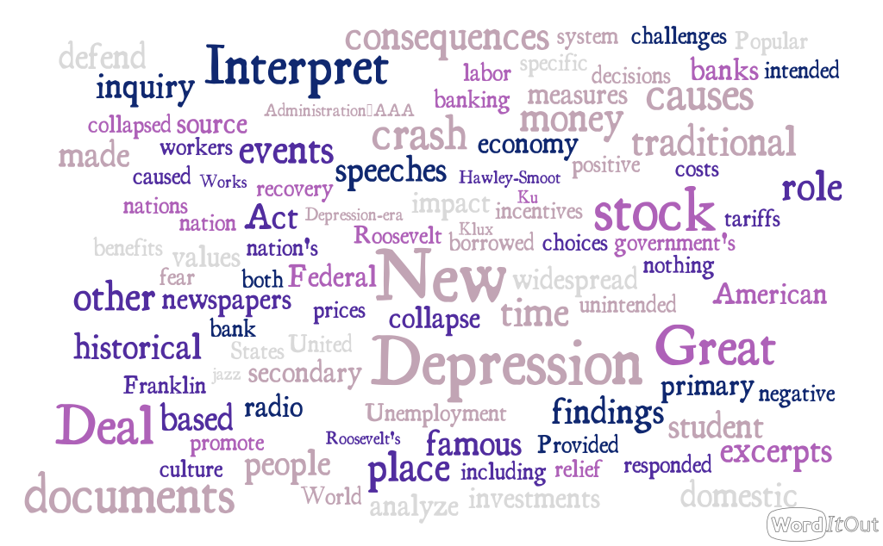
Word Clouds

Slide 8
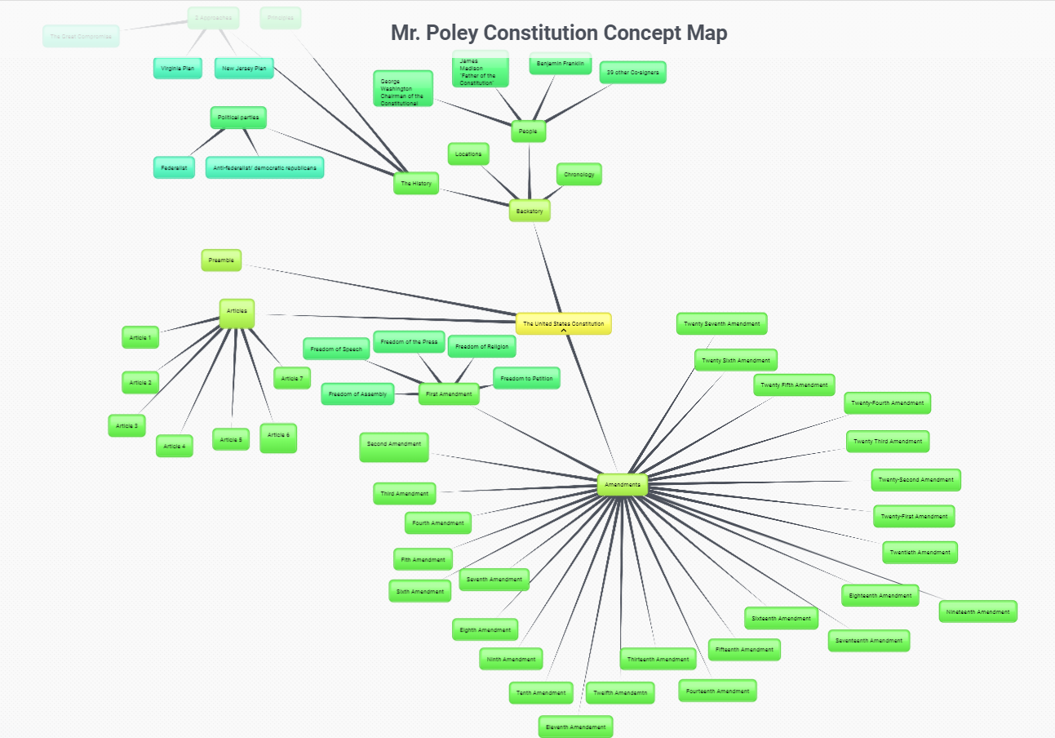
Mr. Poley Constitution Concept Map

Slide 9
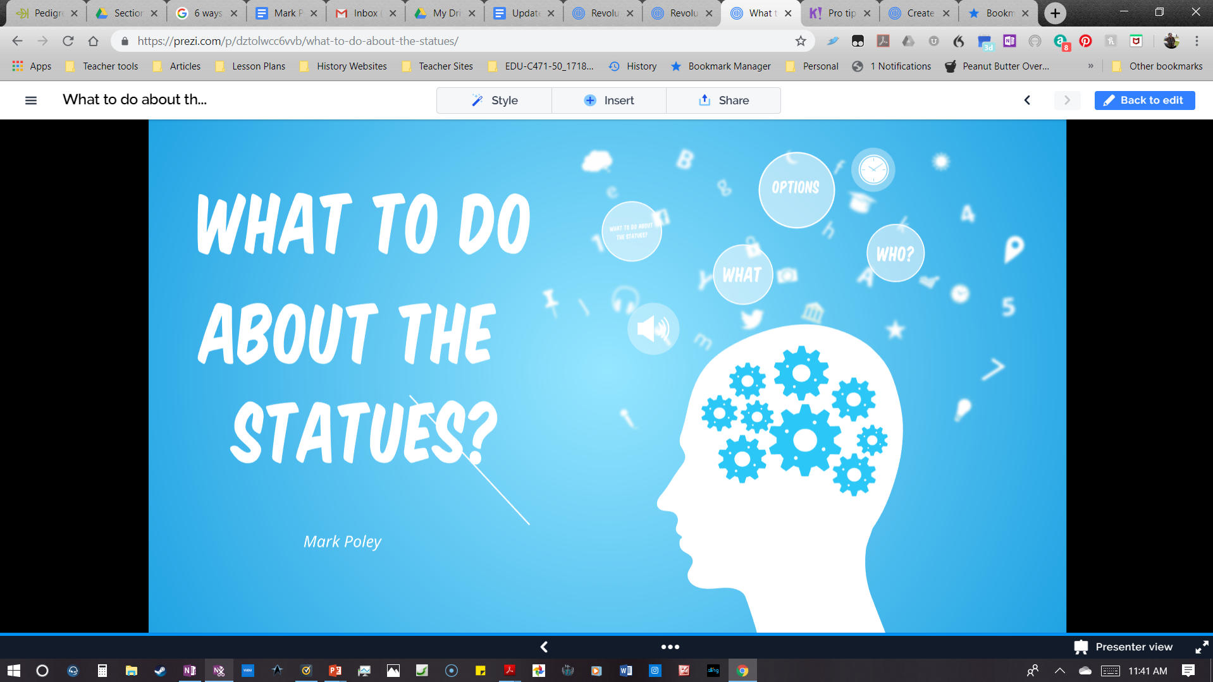
Prezi - What to do about the Statues?
My students love to use Prezi. It has great visual appeal and multimedia capabilities. There are often multiple ways to achieve similar results with technology.

Slide 10
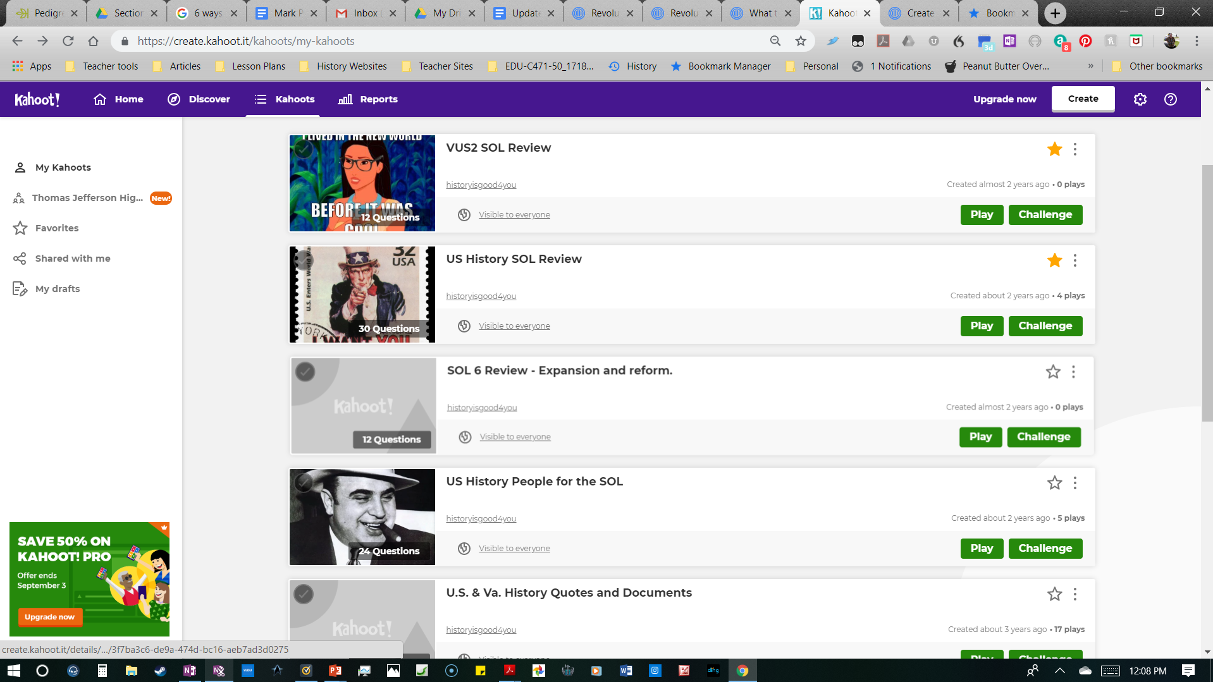
Kahoot games for student engagement
Kahoot games are great fun for our students. They have the look, feel, and sound of a video game and are always a crowd pleaser. There are great features for customization and results tracking which teachers enjoy.

Slide 11
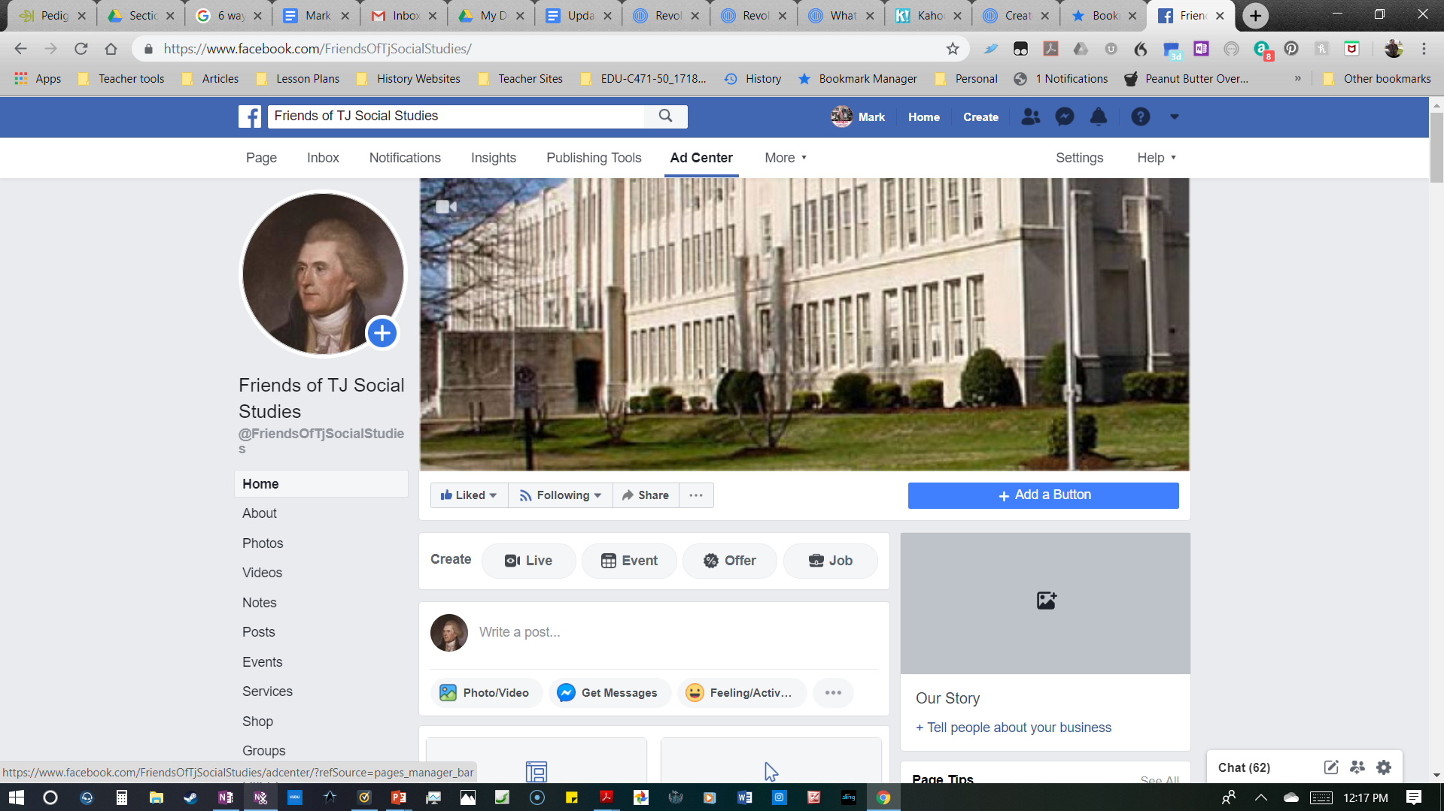
Friends Of Tj Social Studies
Having a Facebook page not only helps with communication, it also affords creative assignments for engaging students, as well as educating by sharing posts from “authentic” online sources.

Slide 12
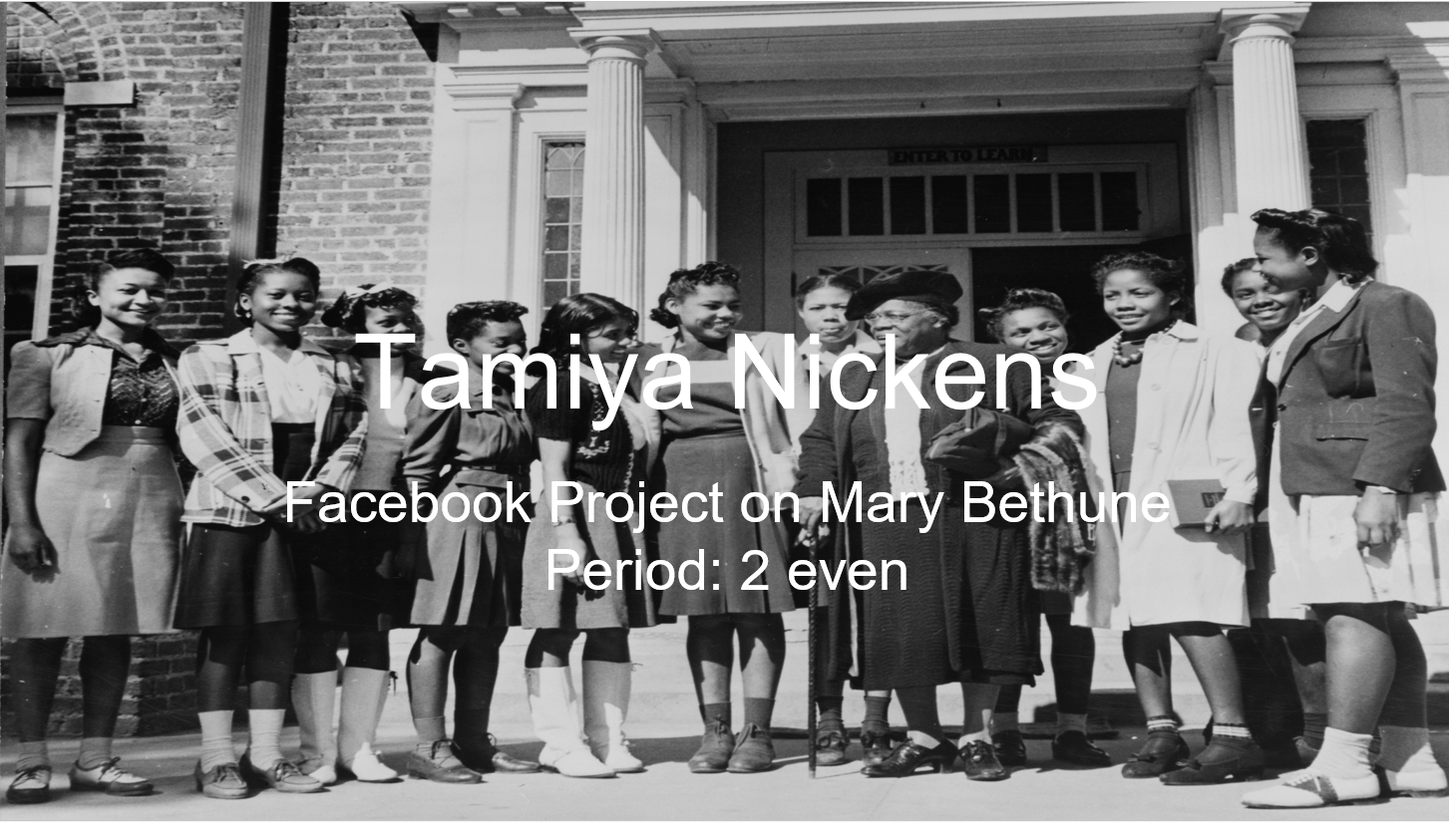
Facebook Project
Students always love to engage with current technology. I would have them create a hypothetical Facebook presence for important figures from history. This project has been a perennial favorite among all my U.S. history students.

Slide 13
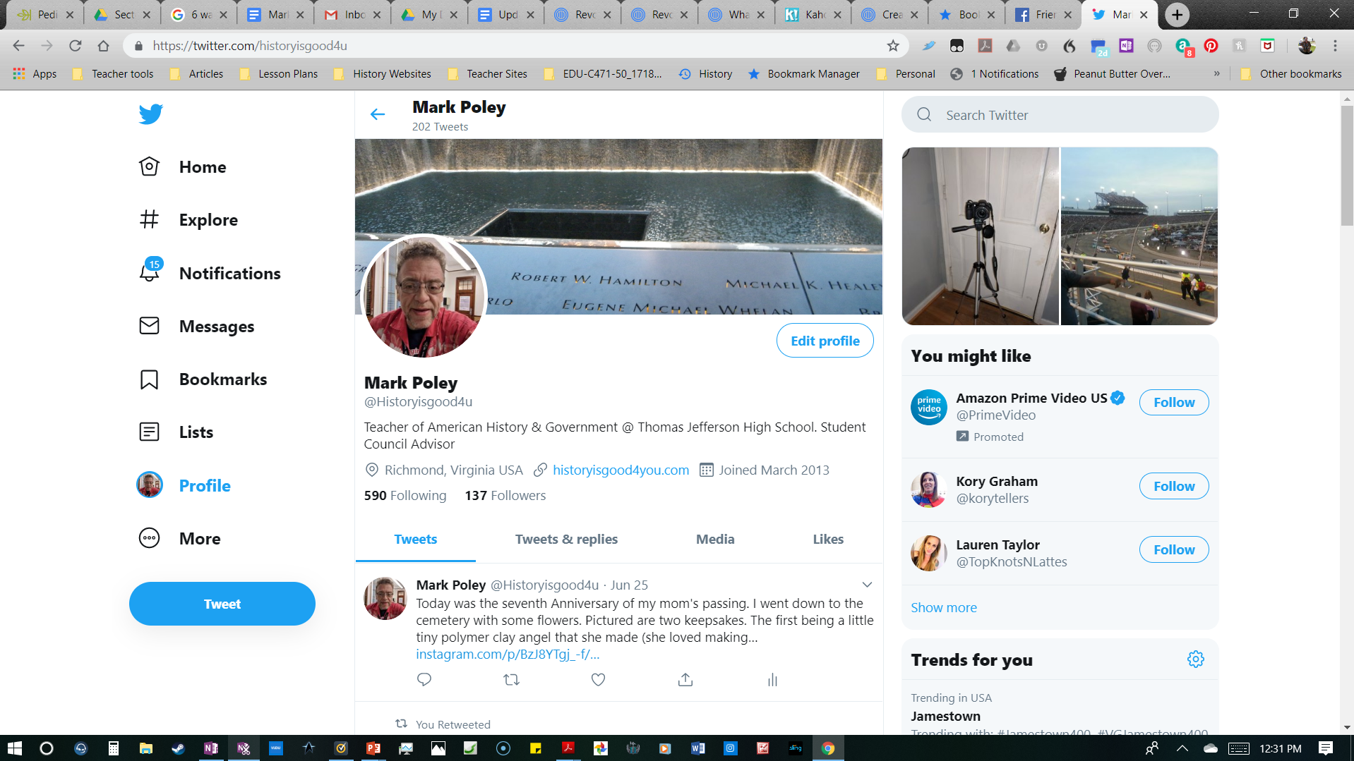
Twitter-@historyisgood4u
One project I am currently very pleased with is “Briefing Day”, where students follow and make presentations on current political figures from a variety of perspectives. There is also a huge community of educators online from around the world on twitter.

Slide 14
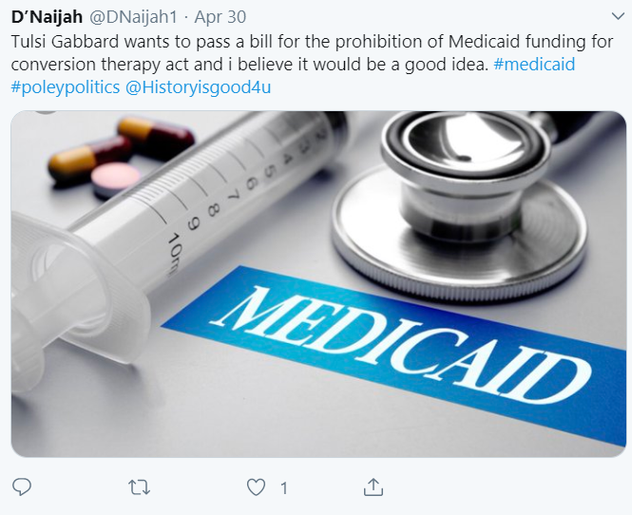
Briefing Day via Twitter
Engaging use of technology in ways that get our students attention is important. I had students follow current members of Congress and 2020 Presidential candidates. They were instructed to make three tweets focusing on different aspects of our current political arena. They would make physical tweets and also complete a paper based template which helped aid in keeping students focused and for grading purposes.

Slide 15

My first presentation on flipping your classroom
I was encouraged by my Principal to take up the flipped classroom, due to my technology background. I researched and presented on it at a Thomas Jefferson faculty meeting. As our students and district grow in their access to technology and related tools this approach could play a much larger role in serving our students.

Slide 16

Mr. Poley & Mr. Dolson State Social Studies Conference presentation
After my initial foray into the flipped classroom I collaborated with a colleague in my department for a district wide, and then a Virginia state Social Studies conference presentation. The flipped classroom has enormous potential for helping student achievement.

Slide 17
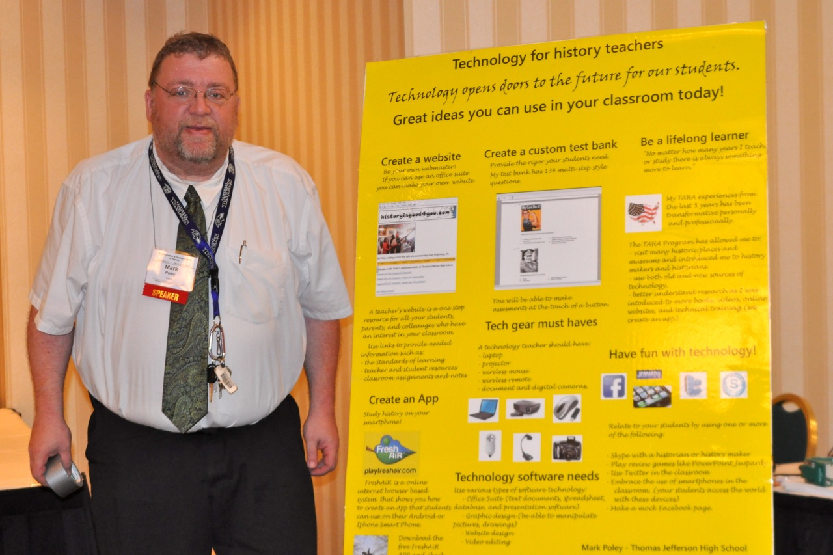
ASALH National Conference October 2011
My presentation was titled,“Technology for History Teachers”. I presented on a variety of technology tools that history teachers could use in the classroom. These tools included: having a website, creating a custom test bank, app creation, and having the necessary technology gear for your classroom.

Slide 18
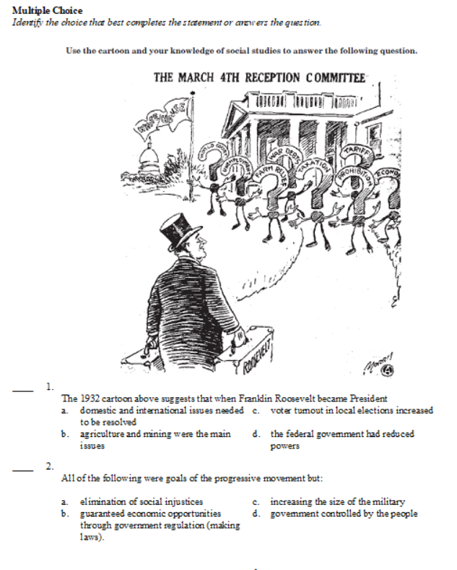
ExamView Testing Software
Prior to our district acquiring access to PowerSchool, I realized the importance of being able to allow my students to practice for SOL testing with the types of questions they would encounter on the test. I researched from test questions that were released at that time, and created custom ones of my own. My custom test bank was searchable by SOL# and strand. It was an important accomplishment for the benefit of my students.

Slide 19
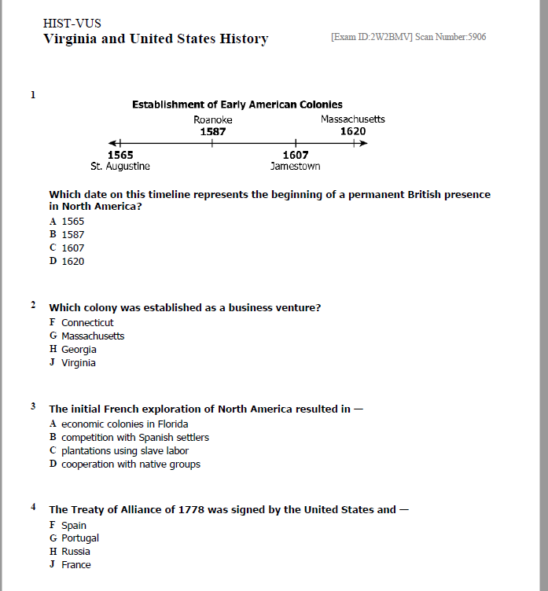
PowerSchool
After our district acquired access to PowerSchool I immediately familiarized myself with this robust testing software and its capabilities. It has impressive capability for customization and tracking of results. I created a variety of quizzes and tests based upon the material I covered in my class.

Slide 20
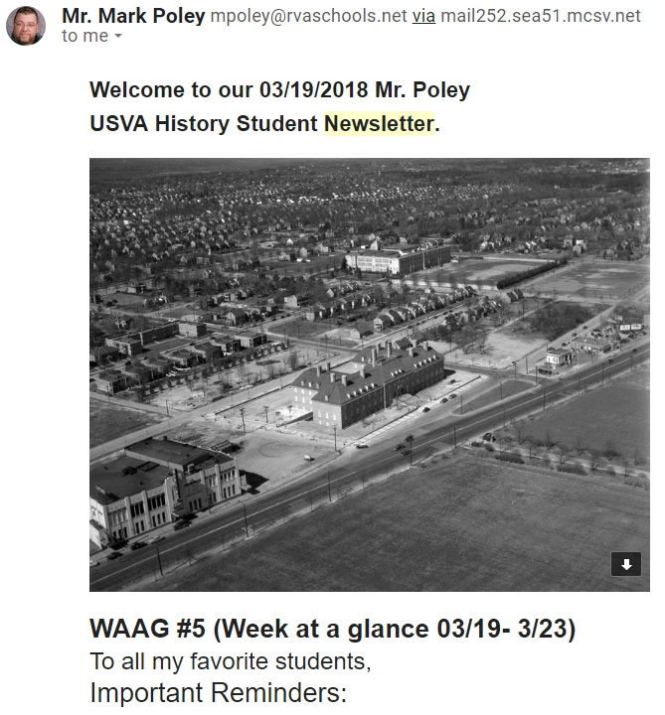
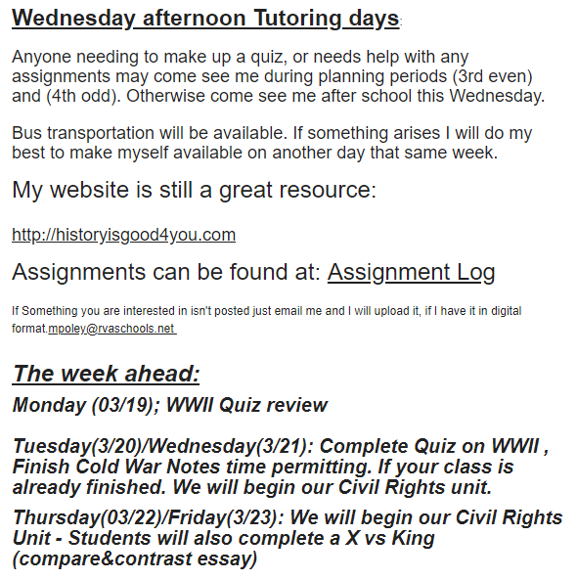
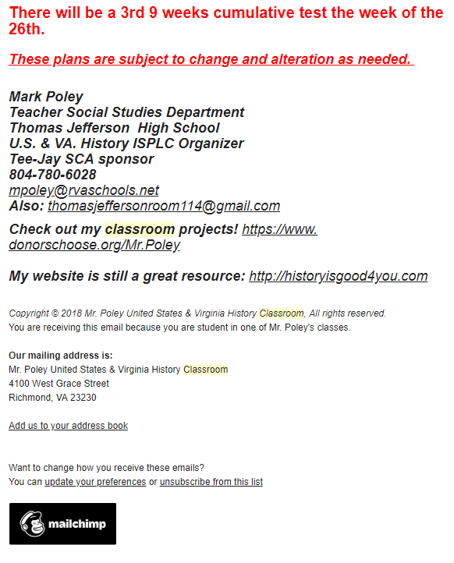
Classroom Newsletters
Classroom newsletters are a great way to communicate with students and parents. Direct email services like mailchimp.com have customizable features, and can even track who opens the emails.

